Slide 1
Station 5 Common Conditions

Slide 2
Knowing What is Common
Grave’s (7): Neck swelling, fever, periodic paralysis, agranulocytosis
Acromegaly (7)
Psoriasis (5): Joint Pain
Systemic Sclerosis (5): SOB
Ank Spond (4): Back Pain
Gout (4): Joint pain
Others: Retinitis pigmentosa, MEN, NF, SLE, HHT, RA, Sjogren’s Tendon Xanthoma, DM, Hypothyroidism, TIA/hemiplegic migraine, CMT, Osteogensis imperfecta, ITP

Slide 3
Grave’s Disease
Scenarios: Neck swelling, Agranulocytosis (sore throat/leukopenia), LL weakness (periodic paralysis)
Symptoms: Tremors, palpitations, increased appetite, weight loss, diarrhea, heat intolerance, oligomenorrhea, anxiety/hypervigilance, eye symptoms
Associations: Hypokalemic periodic paralysis, other autoimmune disorders (pernicious anemia, vitiligo, T1DM, adrenal insufficiency)

Slide 4
Grave’s Disease
Clinical Features
UL: Palmar erythema, sweaty palms, tremors, thyroid acropachy, feel pulse, proximal myopathy
Eyes: Look from top and side, test EOM
Goiter: Diffusedly enlarged, bruit, check retrosternal extension
CVS: Heart failure
LL: Hyperreflexia, pretibial myxedema

Slide 5
Grave’s Disease
Treatment
Pharmacological
Thionamides mainstay (treatment at least 1.5 years), can give propranolol for control of hyperthyroid symptoms
Carbimazole usually first line because lower hepatotoxicity
PTU first line during first trimester of pregnancy because lower risk of teratogenicity (aplasia cutis, tracheoesophageal fistula, choanal atresia); carbimazole first line during second/third trimester
Carbimazole preferred if breastfeeding
Need to counsel about agranulocytosis, hepatotoxicity
Next lines of treatment include radioactive iodine (avoid children or pregnant women for 2 weeks, cannot conceive for 6 months, worsens thyroid eye disease), total thyroidectomy
Thyroid eye disease: Avoid radioactive iodine. Treatment involves ophthalmology referral, smoking cessation, use of eyedrops, prism glasses, steroids, orbital radiation and decompression surgery
Pretibial myxedema: Compression stockings, steroids
Hypokalemic Periodic Paralysis
Acute: Potassium replacement
Chronic: Prevent triggers (high carb meals, vigorous exercise), CAI (acetazolamide)/K sparing diuretics (spironolactone), potassium replacement

Slide 6
Acromegaly
Symptoms: Headache (mass effect, OSA), vision problems, poorly controlled hypertension, tiredness (from OSA), weakness, hand numbness (CTS), BGIT (increased risk of GI malignancy), DM
Features
Hands: Large hands and feet, sweaty hands, CTS
Head and Neck: Coarse facial features, prominent supraorbital ridge, prognathism, increased inter-dental separation, macroglossia, bitemporal hemianopia
Chest and Abdomen: Gynaecomastia (associated raised prolactin), acanthosis nigricans
Organomegaly: Thyroid, heart, liver, spleen, kidneys
Hypertension, colorectal cancer

Slide 7
Acromegaly
Investigations
Acromegaly: IGF1 (screen), OGTT looking non-suppression of GH (confirm), MRI pituitary
Assess other hormones: Prolactin, T4, LH/FSH/testosterone/oestradiol, Short syncathen test/cortisol levels
Cx: OSA (polysomnogram), HTN, BGIT (endoscopic evaluation), cardiomyopathy (ECG, echo), CTS (NCS), DM (FPG, Hba1c)
Treatment: Surgery (mainstay), radiotherapy (adjunct or monotherapy if unfit for surgery), medication (somatostatin analogues like octreotide, dopamine agonists like bromocriptine, GH antagonists like Pegvisomont)
Most physical features do not regress with treatment, however features of active disease (sweating, peripheral edema) do

Slide 8
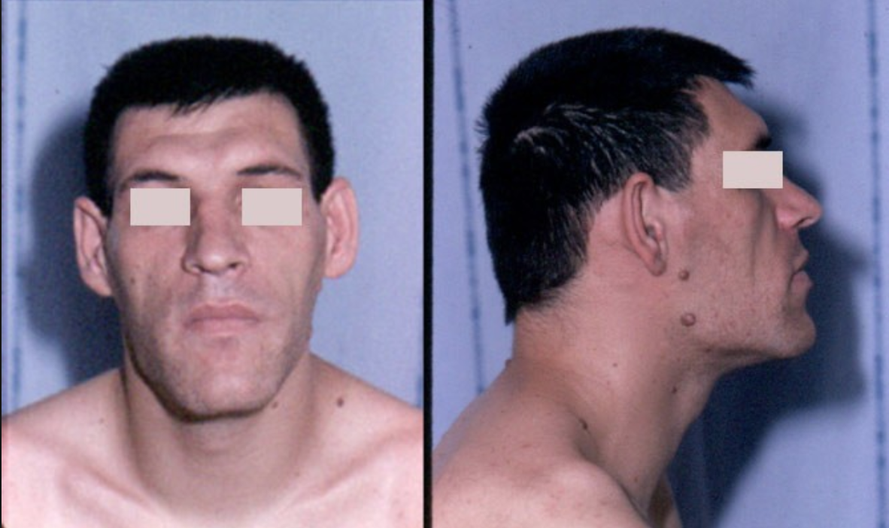

Slide 9
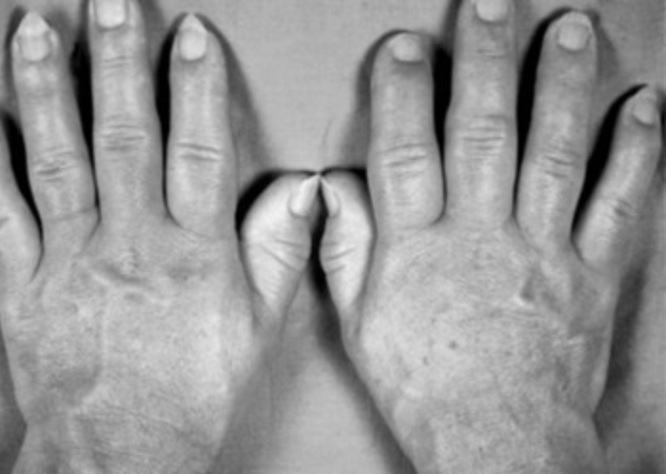

Slide 10
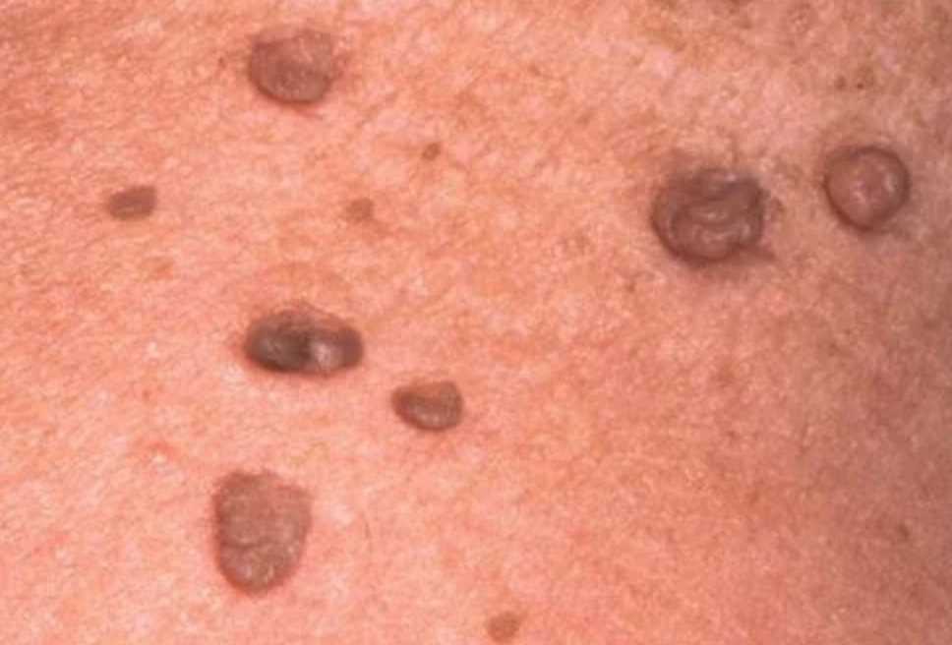

Slide 11
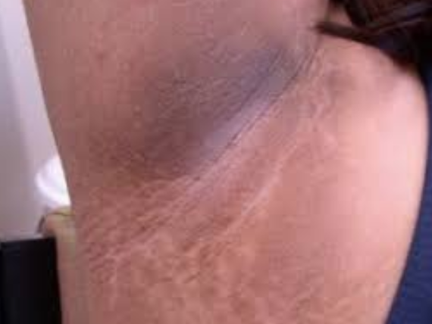

Slide 12
Psoriasis
Symptoms: Joint pain, rash, SOB
Triggers: HIV infection, medication (steroid withdrawal; lithium, beta blockers, NSAIDs, antimalarials)
Clinical Features
Rash: Papulo squamous rash with silvery scales. Patterns include extensor (chronic plaque psoriasis; also scalp, ears), flexural, guttate, pustular, erythroderma
Nails: Pitting, onycholysis, subungual hyperketatosis
Joints: RA pattern, OA pattern, spondyloarthropathy pattern, arthritis mutilans; also ask for enthesitis/dactylitis
Others: ILD

Slide 13
Psoriasis
Investigations
Diagnosis is clinical
Imaging: Joint (pencil in cup appearance, periostitis), CXR (ILD changes)
Management
Topical: Emmoilents, kerotolytic, steroids, coal tar, vit D analogues, vit A antagonist
Phototherapy: UVA, UVB
Systemic: AVOID STEROIDS. Immunomodulators (MTX, ciclosporin), biologics (TNFalpha antagonists)

Slide 14
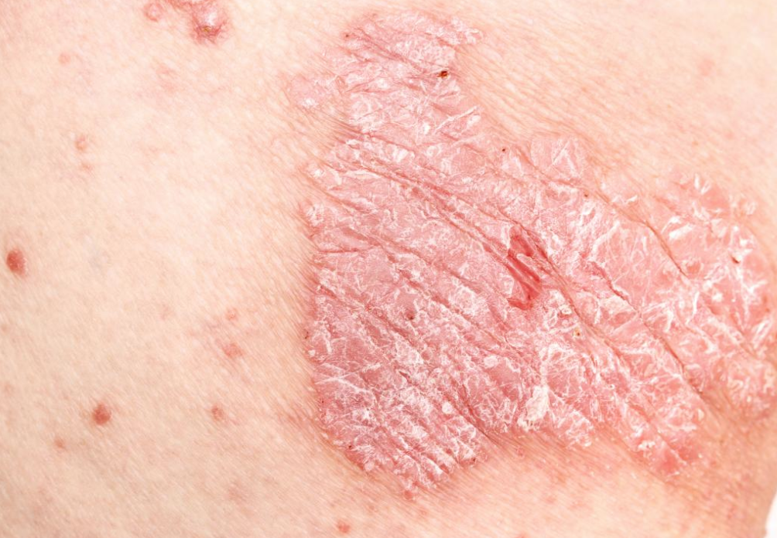

Slide 15
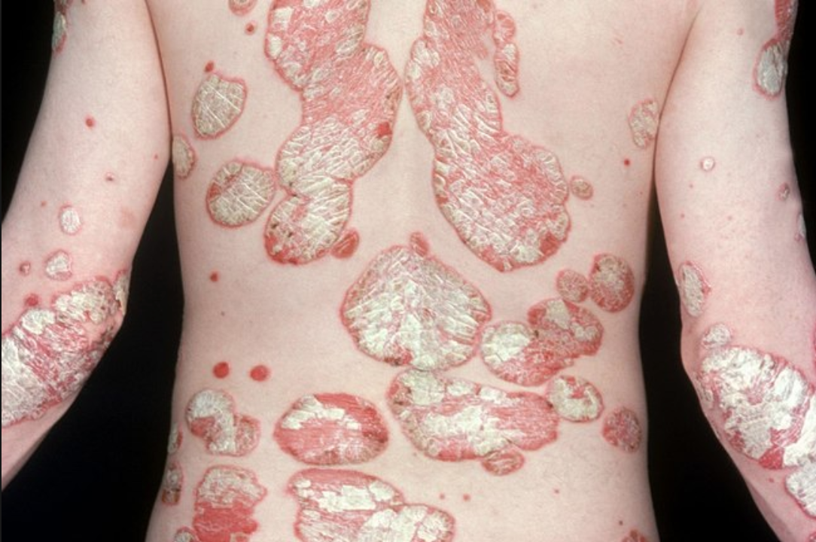

Slide 16
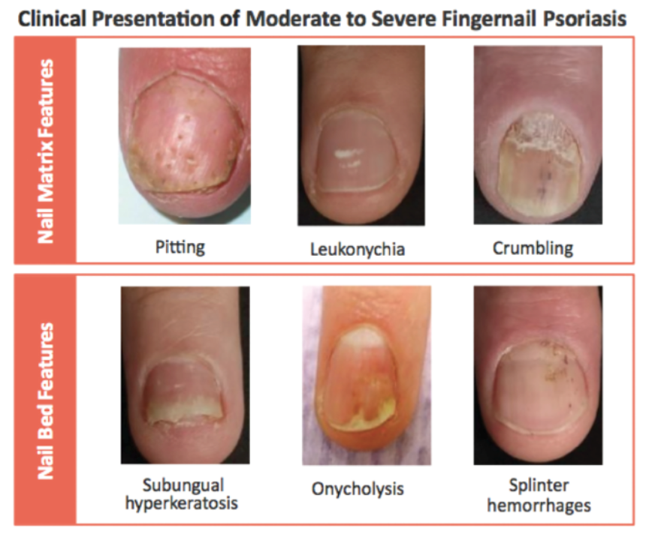

Slide 17
Systemic Sclerosis
Symptoms: SOB (ILD, pulmonary HTN), dysphagia, hand pain/discomfort (Raynaud’s), hypertension with proteinuria (scleroderma renal crisis)
Clinical Features
Important to comment whether limited or diffused
Hands: Sclerodactyly, nailfold telangiectasia, raynaud’s, digital ulcers/pitting
Face: Pinched nose, microstomia, tight skin
Chest: ILD, pulmonary hypertension, salt and pepper appearance
Abdomen: Esophageal dysmotility, SIBO

Slide 18
Systemic Sclerosis
Investigations
Diagnosis is largely clinical, abs mainly for disease prognostication
Antibodies: ANA, Anti-centromere (limited, pulmonary HTN, CREST), Anti-topoisomerase/SCL70 (diffused, ILD), Anti RNA polymerase III: Renal Crisis, Cancer
Endoscopic/functional luminal evaluation
Lung Function Test, HRCT, Echocardiogram
Renal panel, UFEME, Urine PCR
Treatment: NOT STEROIDS – steroids can precipitate renal crisis
Raynaud’s: Gloves/smoking cessation, calcium channel blockers/nitrates/PDE5 inhibitor, sympatectomy
Scleroderma renal crisis: Ace inhibitors, ARBs
Esophageal dysmotility: Proton pump inhibitors, prokinetics
ILD: Immunosuppresants (cyclophosphamide)
Pulmonary hypertension: Diuretics, Phosphodiesterase 5 inhibitor

Slide 19
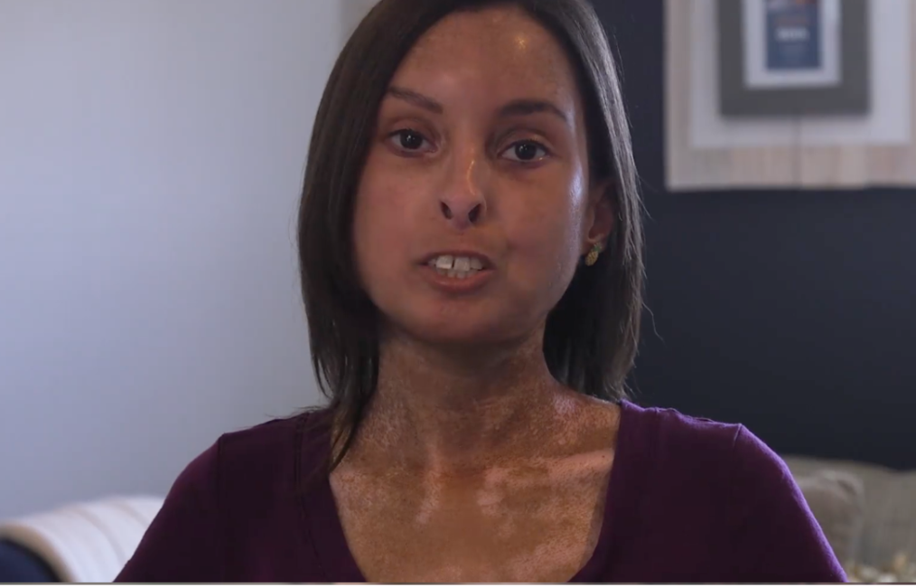

Slide 20
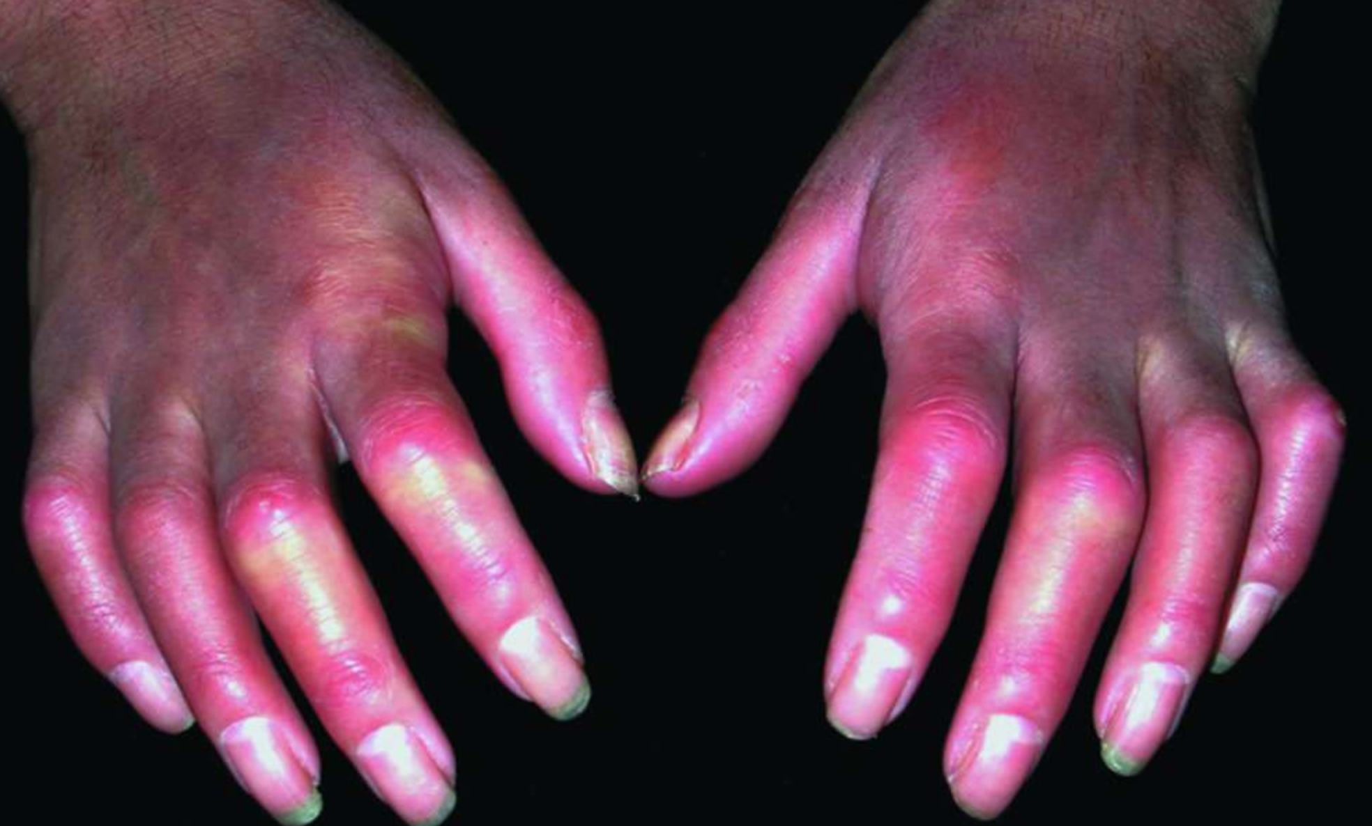

Slide 21
Ankylosing Spondylitis
Symptoms: Back/neck/hip pain/stiffness
Clinical Features:
Description: Stooped posture with cervical hyperextension, thoracic kyphosis and loss of lumbar lordosis with protuberant abdomen
Neck and lumbar ROM, Faber’s test
Occipital wall distance, schober’s test (from PSIS extend 10cm above and 5cm below, excursion should at least be 5cm bending forward), chest expansion (<2.5cm), finger floor distance
Extra-articular manifestations: Anterior uveitis, atlantoaxial subluxation, apical fibrosis, aortic regurgitation, AV node dysfunction, amyloidosis, Achilles tendonitis

Slide 22
Ankylosing Spondylitis
Investigations:
Imaging of spine and SI joint (XR then MRI) looking for: Spine (syndesmophytes, squaring of vertebral bodies, romanus lesions), SI joint (sacroilitis)
Laboratory: ESR/CRP, HLA B27
Complications directed investigations
Management
Multidisciplinary: Rheumatologist, PT/OT
Acute flares: NSAIDs
Biologics: TNF alpha inhibitors

