Slide 1
Rheumatological Disorders (II)

Slide 2
Overview
Behcet’s
Marfan’s
Amyloidosis
Sarcoidosis
Familial Mediterranean Fever
Fibromyalgia

Slide 3
Behcet’s
Clinical Features: Recurrent oral aphthae, recurrent genital aphthae, eye lesions (uveitis, retinal vasculitis), skin lesions (erythema nodosum, aceneiform lesions, papulopustular lesions), vasculitic manifestations
Invx: Pathergy test
Treatment
First line: Topical steroids, topical anesthetics – for ulcers
Second line: Prevention of ulcers with colchicine
Systemic involvement, consider steroid and steroid sparing immunomodulators (decided based on organ involvement)

Slide 4
Marfan’s
Genetics: AD, fibrillin 1 mutation on chromosome 15
Symptoms: Chest pain (aortic dissection, pneumothorax, valve pathology), shortness of breath (valve pathology), vision problems (ectopia lentis)
Clinical Features – LENS, AORTIC VALVE, GENETICS, SYSTEMIC
Key features (based on Ghent’s nosology): Ectopia lentis, aortic valve pathology, aortic dissection (radio-radial delay), fibrillin 1 mutation, family history, systemic features
Hands: Thumb sign, wrist sign, arachnodactyly
Head: Face (Dolicocephaly, retrognathia), Eyes (Ectopia lentis, iridodonesis, enophthalmos), Mouth (high arched palate)
Increased arm span to height ratio, reduced upper segment to lower segment ratio
Chest:
Aortic dissection, aortic regurgitation (aortic root dilation), MVP, pneumothorax
Pectus carinatum
Foot: Pes planus
Beighton score (4 or more positive): Thumb (touch forearm), little finger (>90 degrees), knee hyperextension, elbow hyperextension, touch floor with palms
Investigations: Slit lamp examination (ectopia lentis), Echocardiogram (aortic root evaluation, MVP), Chest Radiograph (pneumothorax), MRI spine (dural ectasia), Genetic testing

Slide 5
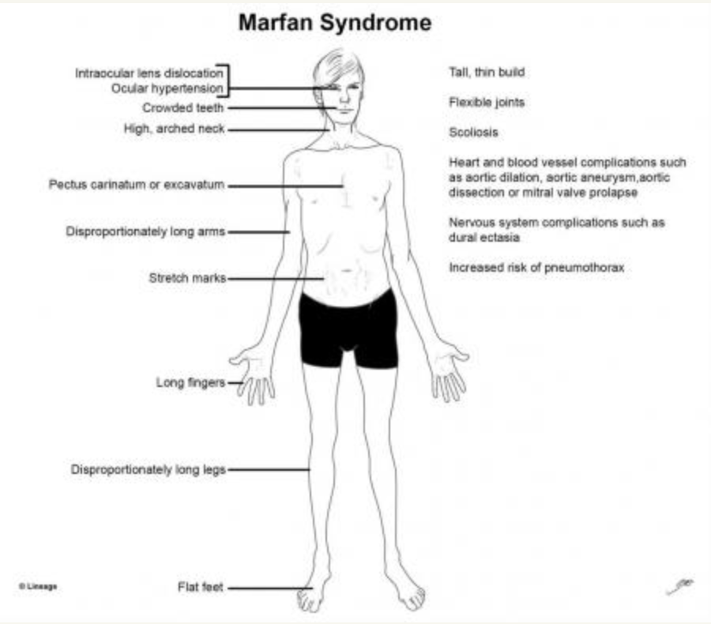
https://pedclerk.bsd.uchicago.edu/page/marfan-syndrome

Slide 6
Amyloidosis
Deposition of abnormal protein (amyloid) in organs (heart, kidney, liver, spleen, CNS, GIT) – nephrotic syndrome, heart failure, cutaneous amyloidosis
Diagnosis: Fat pad aspiration or biopsy (Congo red staining under polarizing microscopy – apple green birefringence) - DEFINITIVE
Supportive: bone marrow biopsy, imaging (echo/MRI)
Types: AL (primary), AA (a/w chronic infection/inflammation, RA, IBD, bronchiectasis), Hereditary Amyloidosis, Dialysis related Amyloidosis
Treatment: AL– Chemo for MM, ASCT, AA – Treat underlying condition, Hereditary – Liver transplantation an option (amyloid protein made in liver), dialysis (changing mode of dialysis or kidney transplant)

Slide 7
Sarcoidosis
Multisystemic inflammatory condition: (Lung + LN) + Skin nodules (lupus pernio) + joint + eye. Granulomas
Other organs: Kidney stones, liver, cardiac, CNS (cause of bilat LMN facial nerve palsy), joint, anterior uveitis
Invx:
Chest imaging: Bilat hilar LN, reticular parenchymal opacities
Pulmonary function test: ILD picture
Biopsy (preferably from peripheral sites like palpable LN, cutaneous lesions; if not then bronch/mediastinal LN biopsy): Histology for granuloma
Treatment: Most patients with asymp/non progressive sarcoid do not need rx. Immunosuppresion. Steroid mainstay. Others: MTX, Hydroxychloroquine
Lofgren’s Syndrome: Acute EN, bilat hilar lymphadenopathy, polyarthritis/arthralgia

Slide 8
Nodular Facial Lesions
-Lupus Pernio
-Discoid Lupus
-Adenoma sebaceums
-Acne

Slide 9
Familial Mediterranean Fever
Genetics: Autosomal recessive
Clinical Features:
Episodic attacks lasting 1-3 days
Fever, serositis (chest, abdomen – may mimic acute abdomen), synovitis, erysipelas skin lesions
Family history
Others: Pericarditis, acute scrotum
Complications: AA Amyloidosis, small bowel IO, infertility
Invx: Raised acute phase reactants, genetic testing
Treatment: Colchicine mainstay

Slide 10
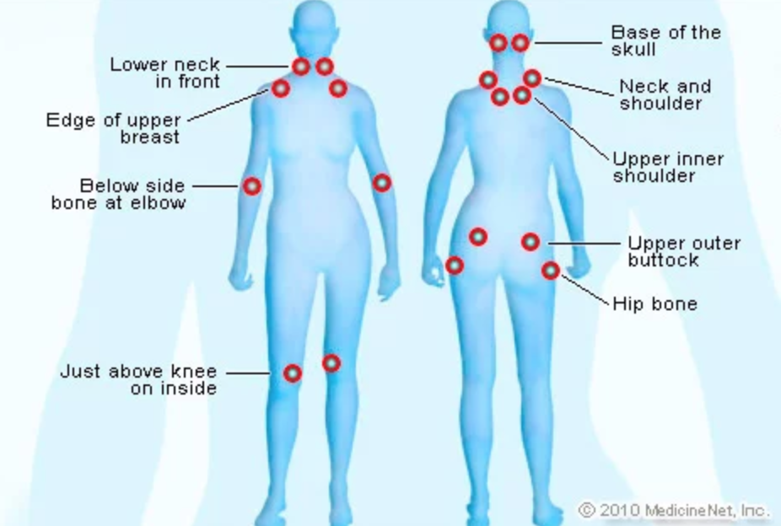
Fibromyalgia
Clinical Features: Characterised by widespread MSK pain accompanied by somatic symps (fatigue, sleep disturbances), cognitive and psychiatric disturbances
Tender points (refer to diagram)
Invx: Laboratory testing normal – Check FBC, ESR/CRP, CK, TSH
Management: Exercise, Antidepressants, Pregabalin/Gabapentin

