Slide 1
Rheumatological Disorders (I)

Slide 2
Overview
Rheumatoid Arthritis
SLE
Antiphospholipid Syndrome
Dermatomyositis/Polymyositis
Sjogren’s

Slide 3
Rheumatoid Arthritis
Symptoms:
Joint pain (small joints, swelling and warmth, early morning stiffness > 1 hour, generally > 6wks)
Systemic: Fever, malaise, lymphadenopathy
Extra-articular manifestations: Eye (scleritis, episcleritis, keratitis), sicca (Sjogren’s association), bronchiectasis/ILD, felty syndrome (neutropenia, splenomegaly, RA), kidneys (amyloidosis), neurological (CTS, mononeuritis multiplex), vasculitis (raynaud’s), neuropathy
SOB in RA
Respiratory: ILD/bronchiectasis, MTX/Leflunomide induced ILD
Fluid: Amyloidosis causing cardiomyopathy and nephrotic syndrome
Infections: Due to immune suppression – CAP, Tuberculosis, PCP

Slide 4
Rheumatoid Arthritis
Examination
Affected joints: Symmetrical deforming polyarthropathy, active vs quiescent, characteristic features (swan neck, boutonniere’s, Z-thumb, ulnar deviation at MCPJ, piano key sign), ROM, function, surgical evidence (if see scar, ask if patient able to move – arthrodesis vs arthroplasty)
Rheumatoid nodules
Hands (telangiectasia, raynaud’s, intrinsic muscle wasting), Eyes (redness), lungs (ILD/bronchiectasis), abdomen (organomegaly for felty’s or amyloidosis)
Investigations
FBC: Infection, neutropenia (felty’s)
Inflammatory markers: ESR, CRP
Antibodies: Rheumatoid factor, anti cyclic citrullinated peptide (CCP), other markers if considering other differentials
Radiological imaging: Soft tissue swelling, peri-articular osteopenia, juxta-articular erosions, loss of joint space, joint subluxation/deformities
Pre immunosuppression tests: RP/LFT, Hep B/C, Ophthalmic testing, latent TB screening

Slide 5
Rheumatoid Arthritis
Management
Multidisciplinary: Rheumatologist, PT/OT
Flares: NSAIDs, steroids
DMARDs: Steroid, steroid sparing immunomodulators (MTX, Leflunomide, Hydroxychloroquine, Sulfasalazine), biologics (TNF alpha: etanercept/infliximab/adalimumab, IL-1: Anakinra, IL-6: tocilizumab, CD20 B cell: Rituximab, T-cell costimulation blocker: Abatacept)
Others: Vaccinations, bone health (Vit D, osteoporosis)

Slide 6
SLE
Symptoms: Rash, hair loss, neurological symptoms, nephrotic/nephritic syndrome, recurrent clotting problems
Clinical Features
Mucocutaneous: Photosensitive rash (malar rash, discoid lupus – check ears, generalized rash), ulcers, hair loss
Arthritis (may be non-deforming: Jaccoud’s arthropathy), serositis
Neurological: Seizures, encephalitis, myelitis, mononeuritis multiplex
Nephrologic: Haematuria, frothy urine, pedal edema
Haematological: Bruising, symptoms of anemia, frequent infections
Antiphospholipid syndrome: Recurrent pregnancy losses, arterial/venous clotting, on examination look for livedo reticularis
Others: GI (lupus gut), MSK (myositis, myalgia), eye (keratoconjunctivits sicca), cardiac (libman-sacks aseptic endocarditis causing valvular insufficiency), raynaud’s

Slide 7
SLE
Investigations
FBC (cytopenias), RP/UFEME/uPCR (renal involvement), PBF (hemolytic anemia)
Antibodies: ANA, anti dsDNA, anti Smith, DCT, antiphospholipid abs (Lupus anticoagulant, anti cardiolipin, anti beta2 glycoprotein 1), complements
Organ involvement targeted investigations: Kidney (biopsy), CNS (imaging, LP), skin (biopsy), respi (CXR), joint (joint XR)
Management
Non-Pharmacological: Sunlight protection, smoking cessation
Hydroxychloroquine (backbone), steroids, steroid sparing immunomodulators (MTX, cyclophosphamide, MMF) – depending on organ involvement, biologics (rituximab)
Organ specific treatment: Joints (NSAIDs), rash (topicals – steroid, tacrolimus), kidney (ACEi/ARB)
Drug induced lupus: Hydralazine, Procainamide, Isoniazid

Slide 8
Antiphospholipid Syndrome
Features (Sapporo criteria)
Clinical: Vascular thrombosis (superficial venous thrombosis does not count), Pregnancy morbidity (loss > 10 weeks gestation, death before 34 weeks gestation due to eclampsia/preeclampsia/placental insufficiency, 3 or more losses < 10 weeks gestation)
Laboratory: Ab positivity at least 12 weeks apart, anti-cardiolipin/lupus anticoagulant/anti beta2 glycoprotein I
Others: Cardiac valve disease, CNS involvement, renal disease, thrombocytopenia, hemolytic anemia
Primary vs association with SLE
Management: Anticoagulation with warfarin (rather than DOAC), LMWH in pregnancy

Slide 9
Dermato/Polymyositis
Symptoms: Rash, weakness, dysphagia, SOB
Clinical Features
Upper Limbs: Gottron’s papules/sign, mechanic’s hands, Raynaud's, nailfold telangiectasia, proximal myopathy
Face: Heliotrope rash (request patients to close eyes – rash might be hidden within lid folds)
Trunk: Shawl sign
Other clinical features: ILD, cardiomyopathy, dysphagia, associated malignancies
Investigations: CK/Aldolase, EMG, MRI muscle, muscle biopsy (DM: Perifascicular atrophy and fibrosis, PM: Intrafascicular cellular infiltrate and inflammation), skin biopsy (for DM), antibodies for prognostication (Antisynthetase ab (Anti Jo-1 – a/w ILD, Raynaud, arthritis, mechanic’s hands), age appropriate screening for malignancy
Treatment: Steroid, steroid sparing immunomodulators

Slide 10
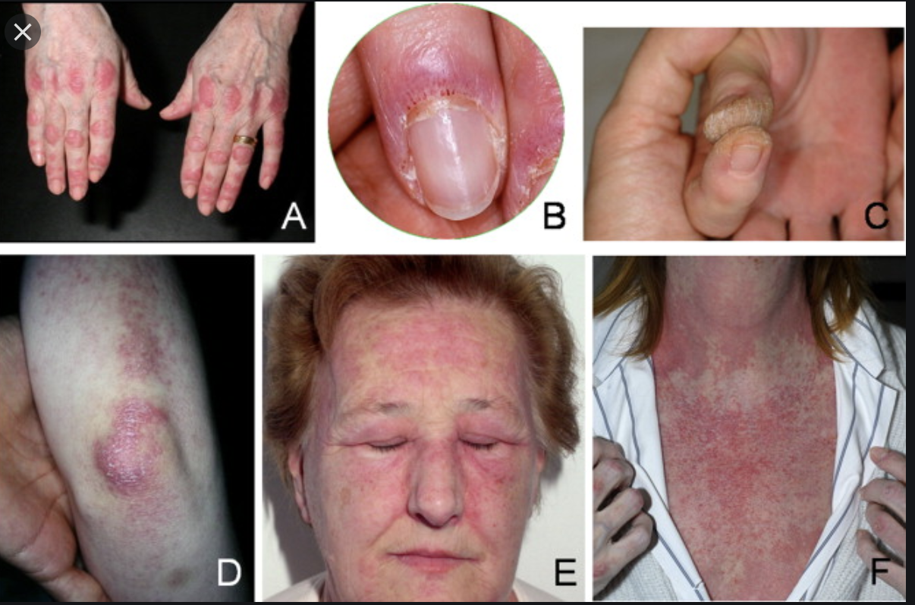

Slide 11
Sjogren’s
Symptoms
Dry eyes, dry mouth (dental caries, difficulty swallowing food because dry, polydipsia with resulting polyuria that can affect sleep)
General: Arthralgia, fibromyalgia
Vasculitis: Raynaud’s, vasculitic rash
Thyroid (autoimmune thyroid disease), lungs (ILD), neurology (various PNS and CNS manifestations e.g. mononeuritis multiplex), haematology (cytopenias, increased risk of lymphoma), renal tubular acidosis
Clinical Features
Parotid gland enlargement
Absence of salivary pooling in mouth, dental caries
Lungs: ILD

Slide 12
Sjogren’s
Investigations
Antibodies: Anti Ro and La
Functional studies to evaluate for dry eyes and salivary hypofunction
Eyes: Schirmer’s test: <5mm in 5 minutes
Salivary Hypofunction: Salivary scintigraphy or sialometry (measure amt of salivary prod)
Imaging: MRI/ultrasound salivary glands
Biopsy: Labial salivary gland biopsy
Treatment
Non-pharmacological: Smoking cessation
Pharmacological:
Mild: Secretagogues (e.g. pilocarpine), moisturizing eyedrops
Severe: Immunomodulators

