Slide 1
PACES Respiratory
Wang Zhemin

Slide 2
Outline
Types of Cases
Approach
Examination Tips
Presentation
Investigations
Management
Specific Conditions

Slide 3
Types of Cases
Commonest
ILD
Bronchiectasis
Pneumonectomy/Lobectomy
Others
Fibrothorax/Collapse/Consolidation
COPD
Pleural Effusion
Pulmonary HTN

Slide 4
Approach
Approach
No Scar
Scar
Trachea Deviated: Pneumonectomy/ Upper Lobectomy
Trachea Central: Pneumonectomy/ Lobectomy
ILD
Bronchiectasis
Others

Slide 5
Examination Tips
Hunt for the scar – it can be pretty faint and well healed!
Inspect for any autoimmune stigmata and RT marks
Inspect carefully for symmetry when patient inspires
Consider dextrocardia for Kartegener’s
If there isn’t a scar, the money is often times at the back so ration your time wisely!

Slide 6
Presentation
Wishlist: Complete my examination by reviewing patient’s temperature charts, perform a bedside pulse oximetry, examine the content’s of the patient’s sputum mug and take a drug/occupational history (especially if ILD)
If confident, cant a state diagnosis upfront
Evidence by “Cardinal features”
Comment on chest expansion, percussion, breath sounds (symmetry, well heard/reduced, adventitious), vocal resonance
Comment on apex beat and trachea
Complications (CPPRR): Cor pulmonale, Polycythemia, Pulm HTN, Respiratory failure, Respiratory Distress
Etiology

Slide 7
Investigations
Plain chest radiograph
HRCT
Pulmonary function test
Invasive: Bronchoscopy (with BAL, TBLB), percutaneous biopsy

Slide 8
Management
Multidisciplinary, involving respiratory physician and allied health staff, anchored in patient education
Smoking cessation, Vaccination (Influenza, Pneumococcal), Chest Physiotherapy
Symptomatic relief: Mucolytics, bronchodilators
Treatment of infective exacerbations with antibiotics
Treatment of underlying disease
LTOT (at least 18 hours)
PaO2</=55mmHg or SpO2 </=88%
PaO2</=59mmgHg or SpO2 </=89% if 1) Cor pulmonale 2) RH failure 3) Erythrocytosis
Surgical: Pneumonectomy/lobectomy (usually for complications), Lung transplant

Slide 9
ILD
Features: Fine end inspiratory crepitations that do not change with coughing, dry cough, clubbing
Causes
Idiopathic
Rheum: Psoriasis, Ank Spond, Systemic Sclerosis, DM/PM, RA
Occupational (asbestosis, silicosis)
Drugs (amiodarone, bleomycin, MTX, isoniazid) and Radiotherapy
Apical vs Basal
Apical: Rheum (Ankylosing spondylitis, Psoriasis, Sarcoidosis), Most pneumoconiosis except asbestosis (silicosis, coal worker pneumoconiosis, berrylosis), RT, TB, ABPA
Basal: Idiopathic, Most rheumatological disorders (scleroderma, dermatomyositis, RA), asbestosis, drug induced (amiodarone, bleomycin, MTX, isoniazid)

Slide 10
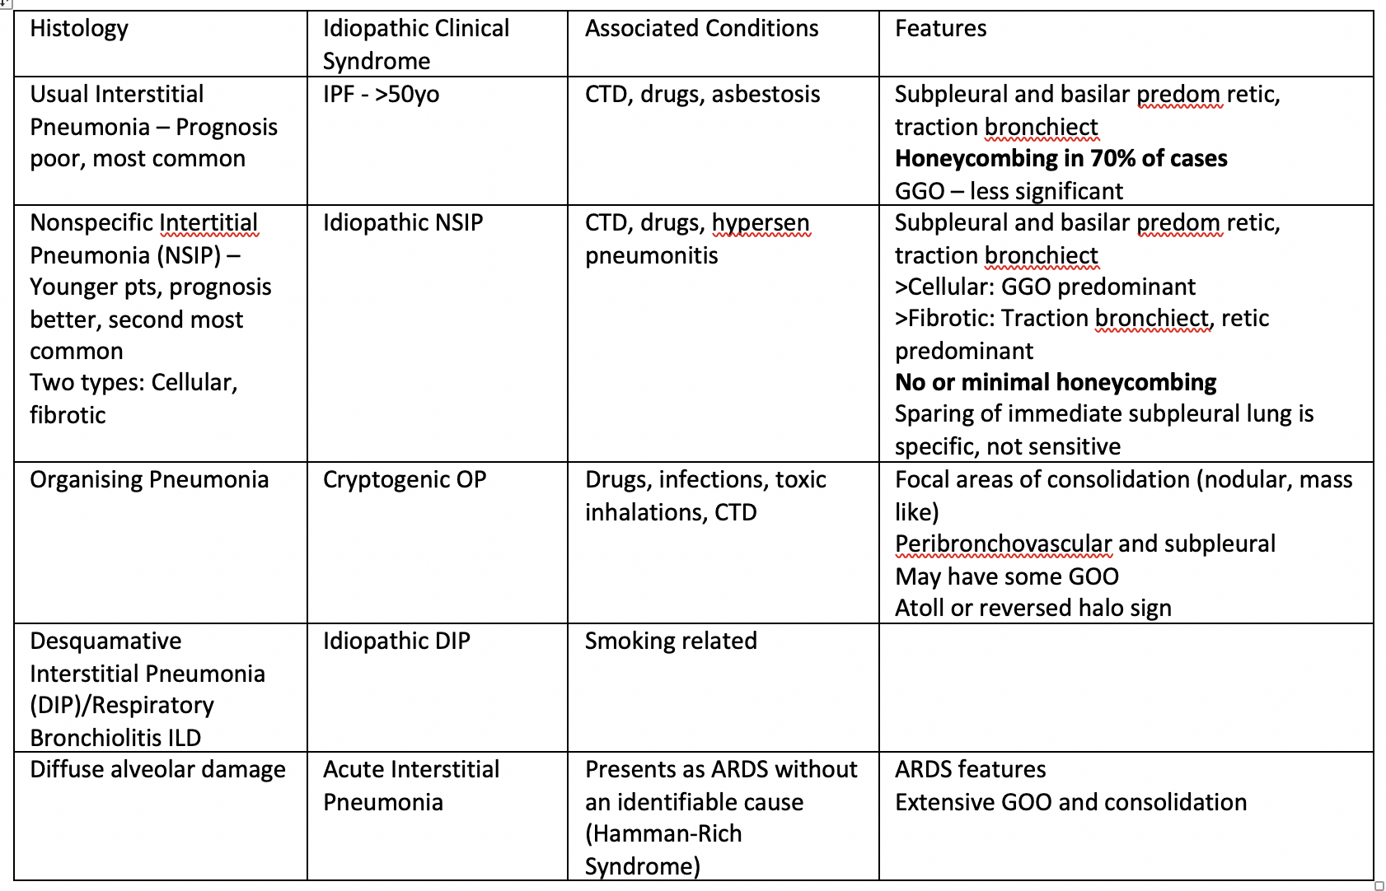

Slide 11
ILD
Investigations
Plain Chest radiograph: Reticular-nodular shadowing
High Resolution Computed Tomography: Ground glass changes, honey combing
Pulmonary Function Test: Restrictive picture (FEV1/FVC > 70%, FVC < 80%, TLC < 80%) with reduced transfer factor (DLCO < 80%)
Lung Biopsy
Etiological Evaluation:
Drug and occupational history
RA: RF, anti-cyclic citrullinated peptide antibody
SLE: ANA, anti-dsDNA, complements
DM: Anti-Jo1 for antisynthetase
Systemic sclerosis: Anti-centromere antibody (localized), anti-topoisomerase (ILD), anti-RNA polymerase (renal crisis)
Complications: Echocardiogram (evaluate for pulmonary HTN – PASP > 25)
Treatment
General treatment (as above), stop offending drug/occupational exposure, immunosuppression (steroid, immunomodulators), consider Perfenidone (antifibrotic) /Nintedanib (TKI) for IPF

Slide 12
Bronchiectasis
Features: Coarse pan/early inspiratory crepitations that change on coughing, chesty cough, clubbing, rmb to check for dextrocardia
Causes:
Congenital: Cystic fibrosis, Kartegener’s Syndrome (dextrocardia, situs inversus, primary ciliary dyskinesia), Hypogammaglobulinemia
Acquired:
Focal: Extraluminal (lymph nodes), luminal (tumour, previous TB), intraluminal (mucus plugging)
Diffused: Post infectious (bronchiolitis obliterans), Rheumatological disorders (RA, SLE, Sjogren’s), Yellow Nail Syndrome (Yellow nails, pleural effusion, lymphedema), ABPA

Slide 13
Bronchiectasis
Investigations
Plain Chest Radiograph: Tram tracks, ring shadows
High Resolution Computed Tomography: Signet ring sign, dilated bronchi
Pulmonary Function Test: Often obstructive picture (FEV1/FVC < 70%)
Etiological Evaluation: Sputum culture, ciliary motility testing, genetic testing and sweat test for CF
Treatment: General treatment (as above), bronchodilators, treat underlying cause
Complications: Recurrent infection, hemoptysis, empyema, disseminated infection

Slide 14
Pneumonectomy/Lobectomy
Clinical Features
Findings are a SPECTRUM!
Tracheal Deviation: Pneumonectomy or Upper Lobectomy
Lobectomy: Findings are generally normal because rest of lung fills up
Pneumonectomy: Tracheal deviation, bronchial breath sounds adjacent to trachea, rest of lung reduced chest expansion, dullness to percussion, absent breath sounds, decreased vocal resonance
Causes: Cancer (Early NSCLC), Abscess, Bronchiectasis with hemoptysis, Tuberculosis, Lung volume reduction surgery, Trauma

Slide 15
Collapse/Consolidation/Effusion/Fibrothorax

Slide 16
Pleural Effusion
Light’s Criteria (1 out of 3 – exudative)
Pleural protein : serum protein > 0.5
Pleural LDH : serum LDH > 0.6
Pleural LDH > 2/3 upper limit of normal serum LDH level
Other pleural fluid tests:
Microscopy: Cell count, cytology
Microbiological: Gram stain, cultures, AFB
Biochemistry: pH (<7.2 suggestive of empyema), glucose (low: malignancy, empyema, RA, TB), ADA, protein, LDH, haematocrit (haemothorax)
Causes
Transudative: Fluid overload (heart failure, renal failure), hypoalbuminemia (nephrotic syndrome, chronic liver disease, hypothyroidism),
Exudative: Parapneumonic effusion, empyema, TB, malignancy, connected tissue disorders
Others: Chylothorax, haemothorax

