Slide 1
PACES Cardiology
Wang Zhemin

Slide 2
Outline
Types of Cases
Approach
Physical Examination Tips
Differentials
Conditions
Presentation
Investigations
Management

Slide 3
Types of Cases
Standard Valve Pathologies: MS, MR, AS, AR, TR, PS (or combinations)
Valve Replacement
“Simple” Congenital Defects: Septal defects, HOCM, Coarctation of Aorta, PDA
“Complex” Congenital Defects: Often with scars, often with cyanosis

Slide 4
Approach
Young
Avoid early commitment to diagnosis especially if possible corrective surgery or cyanotic heart disease
Comment on the following: Young, presence of syndromic features, cyanotic vs acyanotic, scars, murmurs heard
Scars
Valve replacement
Corrective or palliative surgery for congenital or acquired heart disease
Previous CABG
Cyanotic
Eisenmenger’s
Will invariably have pulmonary HTN (Loud P2, parasternal heave)
Differential Clubbing: PDA (LL +/- L UL involvement)
Symmetrical Clubbing: VSD, ASD
May have PR or TR
Congenital cyanotic heart disease – untreated or palliative surgery
BT shunt: Listen for infraclavicular murmur, appreciate reduced volume of radial pulse
Check for dextrocardia
Describe murmurs and offer possible causes

Slide 5
Physical Examination Tips
The pulse: Collapsing pulse, pulse volume
The neck: V waves, Corrigan’s sign
Apex beat: Accentuation, don’t forget dextrocardia
Consider other sites of auscultation
Infraclavicular: BT shunts
Back (Coarctation of aorta, PS can radiate to back)
Using peripheral signs to aid with diagnosis – But with CAUTION!

Slide 6
Differentials

Slide 7
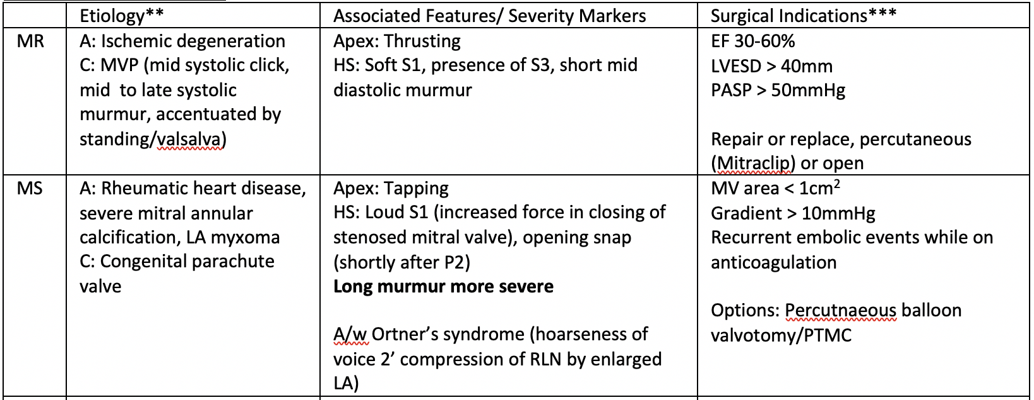
Conditions

Slide 8
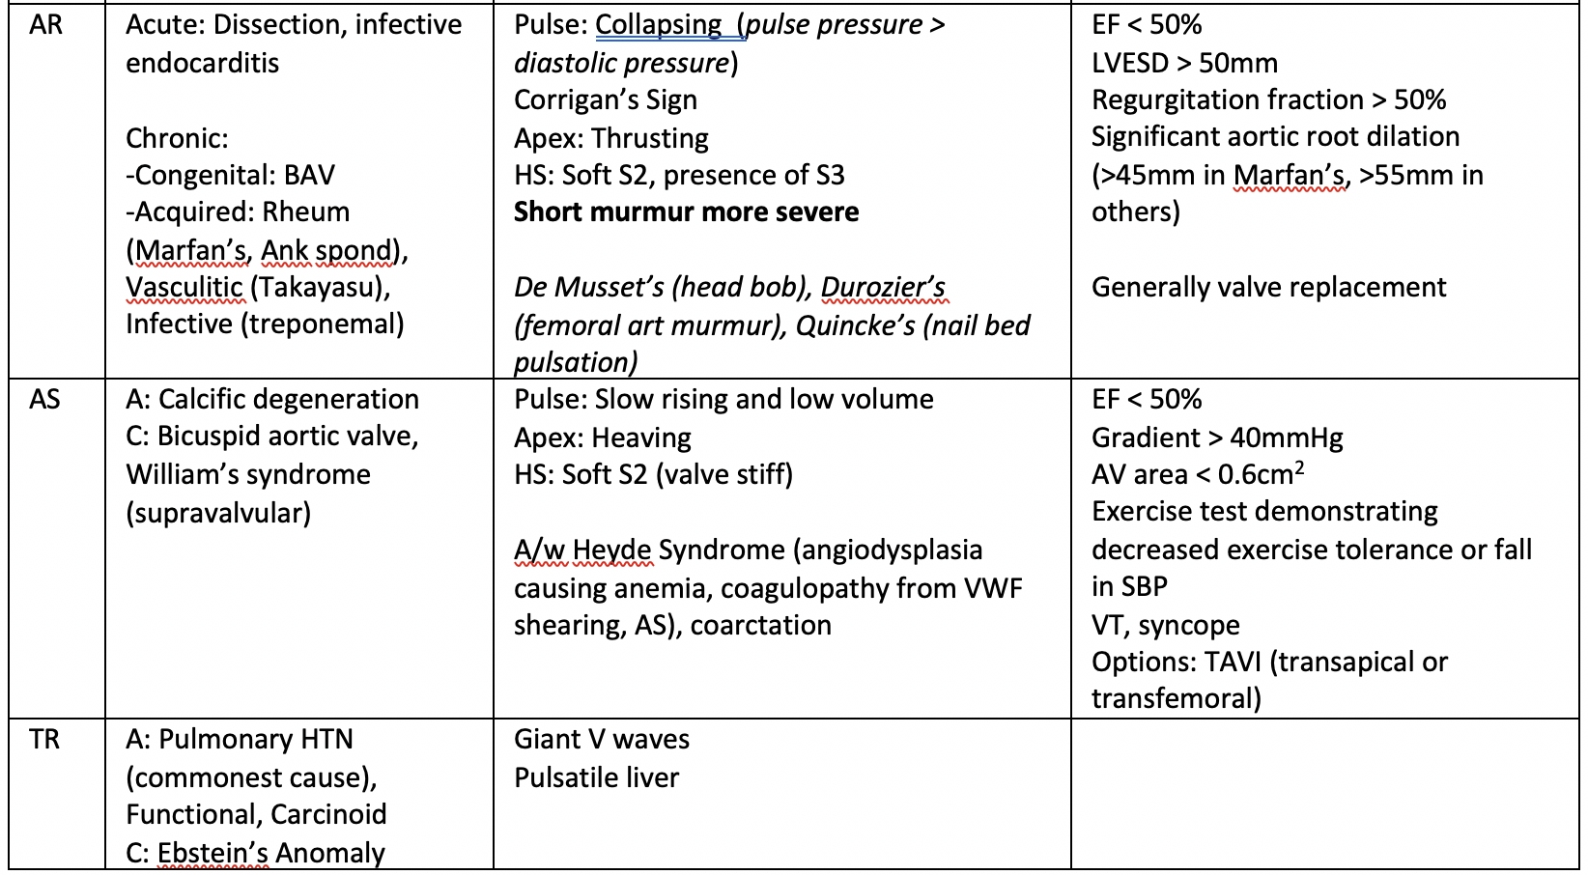
Conditions

Slide 9
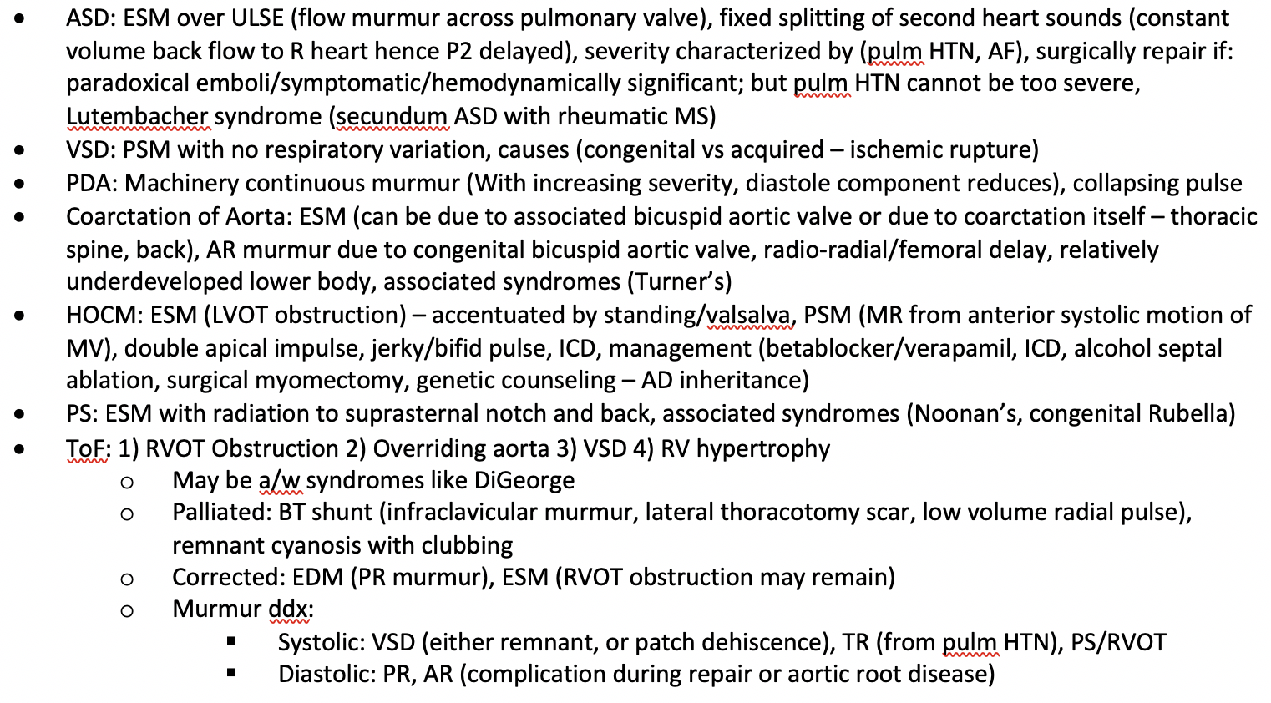
Rarer Conditions

Slide 10
Presentation
Complete examination with wish list: Review blood pressure and temperature, urine dipstick for microscopic haematuria, fundoscopy for Roth spots
Standard:
If confident, can state diagnosis upfront
Type of murmur, best heard where, grade, radiation
Relevant supportive peripheral features, severity markers
Heart sounds, other murmurs, apex beat, pulse
Complications
Standard (PICA): Pulm HTN, IE, CCF, AF
Prosthetic Valve: Valve thrombosis, valve leak, hemolysis
Etiology
Non-Standard: May want to consider a more descriptive approach
Young
Cyanotic vs acyanotic
Scars
Murmurs – Then provide differentials
Heart sounds, apex beat (DEXTROCARDIA), pulse (equality)

Slide 11
Investigations
General
Electrocardiogram: Arrhythmias, chamber enlargement
Plain Chest Radiograph: Features of fluid overload such as Kerley B lines and congested lung fields
Echocardiogram: Confirm diagnosis, evaluate severity and etiology, assess for complications
Prosthetic Valve
PT/INR (or AF on anticoagulation)
FBC, LDH, bilirubin, haptoglobin, peripheral blood film, – Hemolytic anemia
Fluoroscopy to evaluate valve function

Slide 12
Management
Multidisciplinary, involving cardiologist and allied health staff, anchored in patient education
Smoking cessation and control of CVS RF, cardiopulmonary rehabilitation
Generally limited role of medical therapy for valvular pathology, but heart failure treated with GDMT and diuretics
Should patient remain symptomatic despite maximal medical therapy to consider surgery
Replacement vs repair
Open vs minimally invasive approaches (e.g. percutaneous, transapical)
Anticoagulation if atrial fibrillation

