Slide 1
PACES Abdomen
Wang Zhemin

Slide 2
Types of Cases
Hepatology
Chronic Liver Disease +/- Portal Hypertension
Hepatomegaly
Ascites
Liver Transplant (less common)
Renal
Ballotable Kidney – Usually APKD
Transplanted Kidney
Combination of above
Haematology
Haematological Malignancies: Myelo/lymphoproliferative Disorders
Chronic Haemolytic Anemia

Slide 3
Approach
Determining the system – Liver, renal, haematology
Liver: Jaundice, pedal edema
Renal: AVF/AVG, Catheter scars, parathyroidectomy scar, deltoid implant scar
Haematology: Pallor, catheter (for chemotherapy), bony features of extramedullary haematopoiesis
Determining the main abdominal finding
Isolated hepatomegaly/splenomegaly/enlarged kidney
Hepatosplenomegaly vs bilateral ballotable kidney
Transplanted organ
Ascites

Slide 4
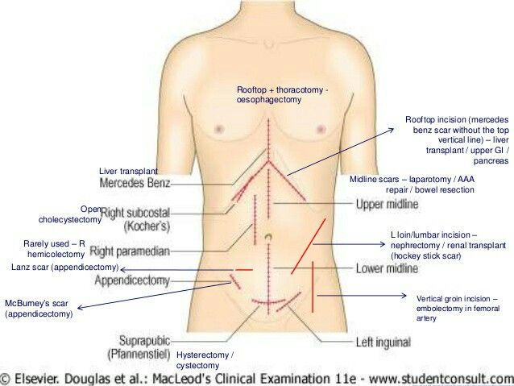
Scars
Mercedes Benz: Liver transplant
Kocher’s Scar (Cholecystectomy): Think chronic haemolytic anemia
Lumbar/Loin Incision: Nephrectomy – although nephrectomy is sometimes done via an laparotomy especially if kidneys are big
Left sided scars: Splenectomy – Think chronic haemolytic anemia
Oblique iliac fossa scar: Kidney transplant
Laparotomy scar: Splenectomy, kidney + pancreatic transplant, bowel sugery (IBD)

Slide 5
Hepatology

Slide 6
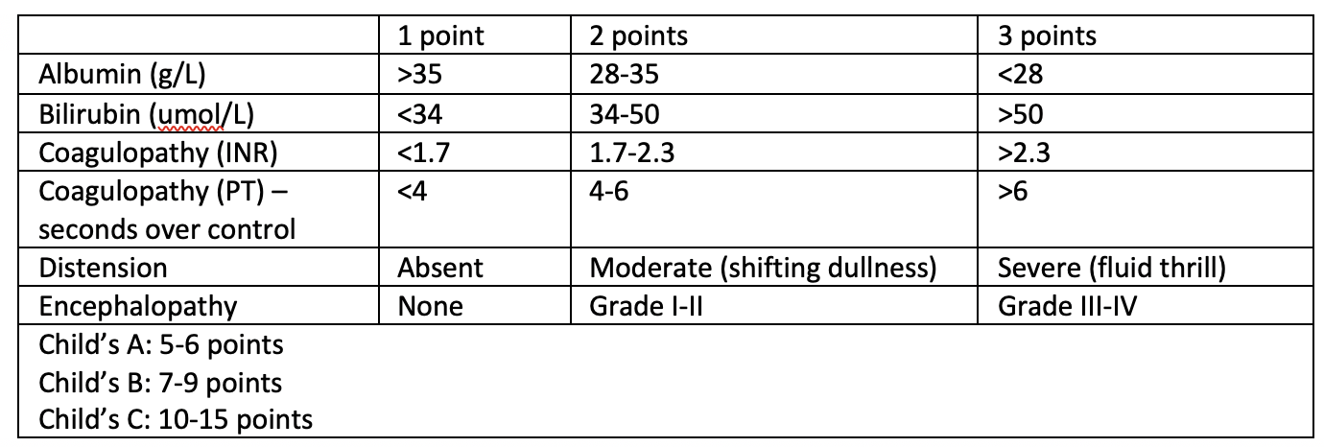
Chronic Liver Disease
Signs: Palmar erythema, gynaecomastia, spider naevi (5 or more), gynaecomastia, loss of axillary hair, testicular atrophy
Severity
Albumin: Pedal edema
Bilirubin: Jaundice
Coagulopathy: Bruising
Distension: Ascites
Encephalopathy: Flap
Etiology: A Very MAD Cow – Alcoholic, Viral hepatitis, Metabolic (NASH, Wilson’s disease, haemochromatosis), Autoimmune (autoimmune hepatitis, primary biliary cirrhosis, primary sclerosing cholangitis), Drug induced, Congestive hepatopathy

Slide 7
Portal Hypertension
Clinically manifested by SPLENOMEGALY and/or ASCITES
Ascites + Abdo Pain: SBP, Portal Vein Thrombosis, HCC Rupture
Ascites Evaluation – Based on SAAG
High (>1.1g/dL): Portal Hypertension (‘Transudative’ equivalent)
Low (<1.1g/dL): Non Portal Hypertension (‘Exudative’ equivalent): Infection, malignancy, TB, rheumatological disorders
Causes of Portal Hypertension
Pre Sinusoidal: Biliary disease (PBC, PSC), portal vein thrombosis
Sinusoidal: Causes of chronic liver disease as above
Post Sinusoidal: Budd Chiari Syndrome (hepatic vein thrombosis; presents with abdominal pain, ascites, liver enlargement), cardiac disease

Slide 8
Hepatomegaly
Etiology
Alcoholic Liver Disease
Non Alcoholic Fatty Liver Disease
Haemochromatosis
PBC
Hepatocellular Carcinoma

Slide 9
Presentation
This is a patient with chronic liver disease +/- complicated by portal hypertension
This is evidenced by stigmata of CLD (list), with associated +/- ascites/splenomegaly. There was no hepatomegaly, and no ballotable kidneys.
In terms of severity, I noted presence/absence – Go through Child’s Pugh features
In terms of etiology

Slide 10
Investigations
Imaging
Characterise organomegaly
Evaluate for mitotic lesions
Evaluate for portal hypertension
Diagnostic paracentesis – If ascites present
Tests: Cell count/cytospin, gram stain/cultures, cytology
>250 PMN suggestive of SBP, treat with ceftriaxone
Etiology Work Up for Chronic Liver Disease
Drug history, ethanol ingestion history
Viral: Anti HCV antibodies, HBsAg and anti-HBc serology
Autoimmune
Autoimmune hepatitis: Anti-nuclear antibody, anti-smooth muscle antibody, IgG, anti liver kidney microsomal antibody, soluble liver antigen
PBC: Anti-mitochondrial antibody
Metabolic
NASH: Fasting glucose/lipids, Hba1c
Wilson’s Disease: Serum ceruloplasmin and urinary copper
Haemochromatosis: Iron panel (ferritin, iron saturation)
Liver biopsy
Evaluation of Severity of Liver disease: Liver function test (albumin, bilirubin), coagulation profile
Complications
Renal Panel: Hepatorenal Syndrome
AFP: Malignancy

Slide 11
Management
Multidisciplinary, involving hepatologist and allied health staff, anchored in patient education
Ethanol avoidance, hepatitis virus vaccinations, education on food hygiene, avoid hepatotoxic drugs
Treatment of underlying disease
Screening: OGD (varices), AFP/imaging (HCC)
Treat Complications
Ascites: Salt restriction, diuretics, therapeutic paracentesis
SBP Prophylaxis [With fluoroquinolone (Ciprofloxacin)]: Primary (cirrhosis + BGIT, cirrhosis + ascites with fluid protein < 1.5g/dL w renal/hepatic failure), Secondary (previous SBP)
Varices: Non selective beta blockers (propranolol), variceal band ligation

Slide 12
Renal

Slide 13
General
Ballotable kidneys – APKD
ESRF?
Evidence of RRT (previous & present): AVF/AVG (must hunt), HD/PD catheters, transplant
Complications
Anemia
Bone health – Parathyroidectomy/deltoid implantation scars
Fluid status
Uremia – Flap, pericardial rub, coagulopathy
Etiology: APKD, DM, HTN, GN
Transplant: Graft function, immunosuppression

Slide 14
Ballotable Kidneys
Causes
Unilateral: Neoplasm, Asymmetrical APKD, Hydronephrosis
Bilateral: APKD, Syndromic Neoplasms (Tuberous Sclerosis, VHL), Bilateral Hydronephrosis, Acromegaly, Amyloidosis
Other Syndromes a/w Renal Neoplasms:
Tuberous sclerosis (Angiomyolipomatosis)
Von Hippel Lindau (Clear Cell RCC)

Slide 15
ADPKD
Inheritance: AD, PKD 1 on Chr 16, PKD 2 on Chr 4
Associations/Complications
Hypertension, Polycythemia
Extrarenal: Abdomen (diverticular disease, abdo wall hernia), Brain (berry aneurysms at MCA/ICA – CN3, hemiparesis), Cardiac (MVP, MR, AR), Cysts involving other sites (liver, pancreas)
Renal: Infection, bleeding, malignant transformation
Diagnosis: Family History + Supportive Sonographic Findings
Screening
US Kidneys: Ravine’s Diagnostic Criteria
<30yo: 2 cysts in either 1 or both kidneys
30-59yo: At least 2 cysts in each kidney
>60yo: At least 4 renal cysts in each kidney
CNS Screening
Indications: Family history of ICH/known aneurysm – rescreen 5 yearly (if normal)
Indications for nephrectomy: Complications (bleeding, infection), space constraints for kidney transplant

Slide 16
Renal Allograft
Questions to Answer: Etiology, Prev RRT, Graft function, immunosuppression, complications of ESRF
RIF mass ddx: Caecal carcinoma, crohn’s disease, ovarian tumour, ileocaecal/appendiceal abscess
Immunosuppression
Steroids: Habitus (rounded countenance, truncal obesity, supraclavicular fat pads), skin thinning/easy bruisability, proximal myopathy, cataract, oral thrush, abdominal striae, spinal tenderness (compression fracture)
Calcineurin Inhibitors
Cyclosporine: Gingival hypertrophy, hypertrichosis, hypertension
Tacrolimus: Tremors, DM (NODAT)
Generally also look out for rash/skin lesions (increased risk of dermatological malignancy)
Transplant Complications
Acute: Surgical complications (anastomotic leak), Acute rejection
Chronic:
Immunosuppression related: OI, derm/haemato malignancy
Rejection, delayed function
Disease recurrence

Slide 17
Haematology

Slide 18
Myelo/Lymphoproliferative Disorders
Additional Examination: Lymphadenopathy (Cervical, axillary, inguinal), BMA scar
Types of Myeloproliferative Disorders: Polycythemia Rubra Vera, Essential Thrombocytosis, Chronic Myeloid Leukemia, Myelofibrosis
Investigations
FBC: Quantitative abnormalities of cell lines
Peripheral blood film: Blast cells, leukoerythroblastic picture (marrow disruption – seen in MF)
Imaging: Evaluation of organomegaly, lymphadenopathy, complications (e.g. thrombosis)
Bone marrow aspirate: Cytology, histology, immunohistochemistry, cytogenetics
Specific Tests: JAK2 (ET, PRV), Philadelphia Chromosome (CML)
Treatment
PRV: Phlebotomy, hydroxyurea, aspirin
ET: Hydroxyurea, aspirin
CML: TKI (e.g. Imatinib), stem cell transplant
MF: Hydroyxyurea, stem cell transplant

Slide 19
Chronic Haemolytic Anemia
Examples: Thalassemia, hereditary spherocytosis
Additional Examination
Bony features of extramedullary haematopoiesis: Frontal bossing, maxillary hyperplasia
Abdominal Scars: Cholecystectomy, Splenectomy
Complications of Iron Overload: Hepatomegaly, fluid overload from heart failure, diabetic prick marks
Investigations
FBC: Anemia
Hemolysis: LFT, Haptoglobin, Peripheral Blood Film (anisocytosis/poikilocytosis, fragments from hemolysis)
Hb Electrophoresis: Elevated HbA2 in beta-thal
Genotyping/Mutation Analysis
Management
Transfusions, folate supplement, iron chelation
Splenectomy (to reduce splenic sequestration and RBC consumption) – will need vaccination against encapsulated bacteria (pneumococcus, meningococcus, haemophilus influenzae
Bone marrow transplant
Treat complications (iron overload – DM, hormonal insufficiency, CLD, heart failure, osteoporosis)
Genetic counseling

