Slide 1
Neurocutaneous Syndromes

Slide 2
Overview
Neurofibromatosis
Tuberous Sclerosis
Sturge Weber

Slide 3
Neurofibromatosis
Genetics: AD inheritance, NF1 (Chr 17), NF2 (Chr 22)
Clinical Features:
NF1: (FIBROMA) Fibroma, Iris harmatomas, Bony lesions, Relative, Optic glioma, Macules, Axillary Freckling
NF2: Acoustic neuroma (check hearing important!), other tumours (neurofibroma, meningioma, glioma, schwanoma)
Physical Examination: Inspection, radioradial delay, eyes, hearing, axilla, abdomen (scars from pheo surgery) inspect long bones
Management: Genetic counseling, analgesia, surgery for compressive lesions
Hypertension: Pheochromocytoma, renal artery stenosis, coarctation of aorta

Slide 4
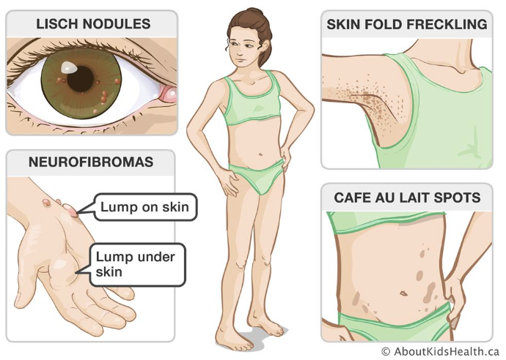
https://www.aboutkidshealth.ca/article?contentid=864&language=english

Slide 5
Tuberous Sclerosis
Genetics: AD
Clinical Features
Face: Adenoma sebaceum (papular lesions)
Body: Ash leaf macule, shagreen pataches, café-au-lait spots
Tumours: Angiomyolipomas (kidneys), lymphangiomyomatosis (lungs), periorbital/retinal harmatomas (eyes), rhabdomyoma (heart)
A/w seizures (tuberous masses in cerebral cortex)
Management: Genetic counseling, treat epilepsy

Slide 7
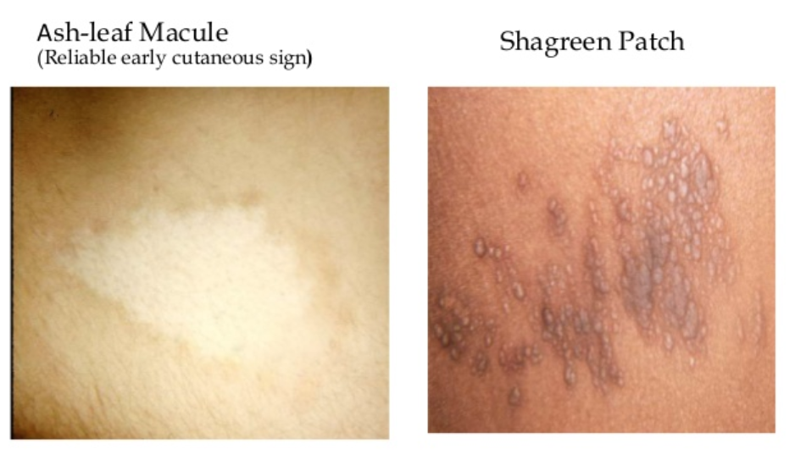

Slide 8
Sturge Weber
Genetics: Not clearly demonstrated
Clinical Features: Ipsilateral port wine stain (V1), ipsilateral vascular abnormalities (leptomeningeal angioma), contralateral neurological manifestations (hemiparesis, seizures)
Invx: Skull XR (Tram track), CT/MRI Brain (Leptomeningeal angioma)
Management: Treat epilepsy

Slide 9
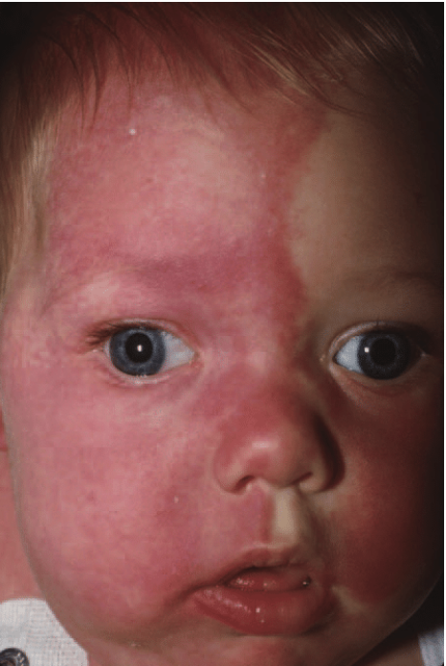
https://www.researchgate.net/figure/Patients-with-Sturge-Weber-syndrome-normally-have-a-port-wine-birthmark-and-usually-have_fig1_7061035

