Slide 1
Neoplastic Syndromes

Slide 2
Overview
MEN Syndrome
Von Hippel Lindau
Peutz Jeghers Syndrome
Carcinoid Syndrome

Slide 3
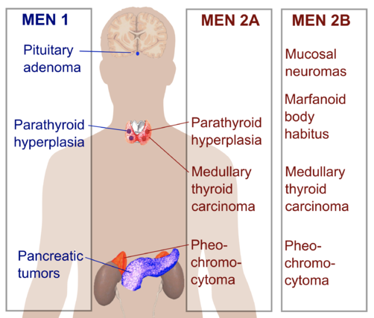
MEN Syndromes
MEN 1: Pituitary, Parathyroid, Pancreas (Insulinoma, gastrinoma, glucagonoma, VIPoma)
MEN 2a: Parathyroid, Pheochromocytoma, Thyroid (Medullary)
MEN 2b: Pheochromocytoma, Thyroid (Medullary), mucosal neuromas/marfanoid body habitus
https://en.wikipedia.org/wiki/Multiple_endocrine_neoplasia#/media/File:Multiple_endocrine_neoplasia.png

Slide 4
Pheochromocytoma
Associated Syndromes: MEN2, VHL, NF1
Clinical Features:
Triad of: Headache, sweating, palpitations/tachycardia
Hypertension, tremors
Investigations: Urinary and plasma fractionated metanephrines and catecholamines, cross sectional imaging (CT/MRI)
Management: Alpha block with phenoxybenzamine then beta block, surgery after

Slide 5
Von Hippel Lindau
Genetics: AD
Associated Cancers:
PACES Relevant: Pheochromocytoma, Clear Cell RCC, Neuroendocrine Tumours of Pancreas
Others: Retinal hemangioblastomas, papillary cystadenomas of epididymis/broad ligament, middle ear endolymphatic sac tumours
Management: Genetic counseling, guideline based surveillance screening, surgery

Slide 6
Peutz Jeghers Syndrome
Genetics: AD – STK 11 gene
Clinical Features: Multiple hamartomatous polyps, mucocutaneous pigmentation (lips, perioral, buccal mucosa, palms, soles), increased risk of GI (colon, pancreas) /non-GI (breast) cancer
Investigations: Genetic testing

Slide 7
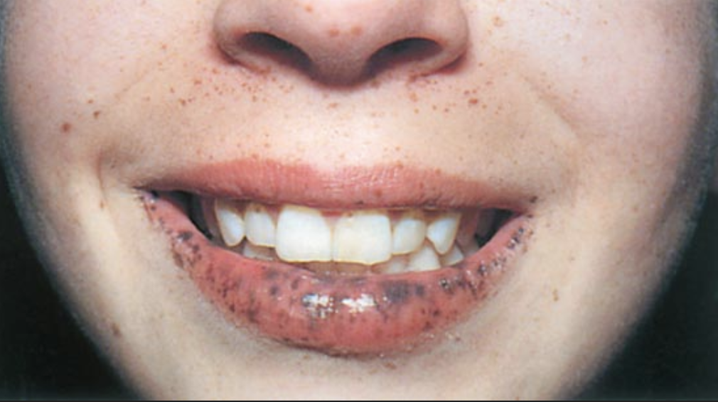
https://step2.medbullets.com/gastrointestinal/120177/peutz-jeghers-syndrome

Slide 8
Carcinoid
Causes: Usually small bowel neuroendocrine tumours; but can be gastric and lung too. Usually by the time carcinoid syndrome presents, there is liver metastases; symptoms are due to secretion of hormonal products like serotonin/prostaglandin/histamine
Clinical Features: Flushing, diarrhea, bronchospasm, right sided cardiac valve disease
Invx: 24H urinary collection of 5-HIAA (hydroxyindoleacetic acid), diagnostic imaging (with radiolabeled somatostatin analogs)
Management: Treatment of underlying cancer in consult with oncologist, somatostatin analogues like octreotide for cardinoid syndrome

