Slide 1
Hereditary Disorders

Slide 2
Overview
Hereditary Hemorrhagic Telangiectasia
Retinitis Pigmentosa
Hereditary Angioedema
Acute Intermittent Porphyria
Osteogenesis Imperfecta

Slide 3
Hereditary Hemorrhagic Telangiectasia
General: AD disorder, Onset often begins in childhood
Clinical Features: Epistaxis, mucocutaneous telangiectasia, visceral involvement (pulmonary/hepatic – hepatic bruit! /CNS AVMs)
Diagnosis: Consensus Criteria (Curacao Diagnostic Criteria)
Spontaneous and recurrent epistaxis
Multiple mucocutaneous telangiectasia at characteristic sites
Visceral involvement (GI, pulmonary, cerebral, hepatic)
First degree relative with HHT
Complications: Heart failure, portal HTN, abscesses
Treatment:
Non-pharm: Humidification, local ointments
Pharmacological: Tamoxifen, tanexemic acid, bevacizumab
Address iron deficiency anemia - Transfusion
Interventional therapy/surgery: Organ targeted

Slide 4
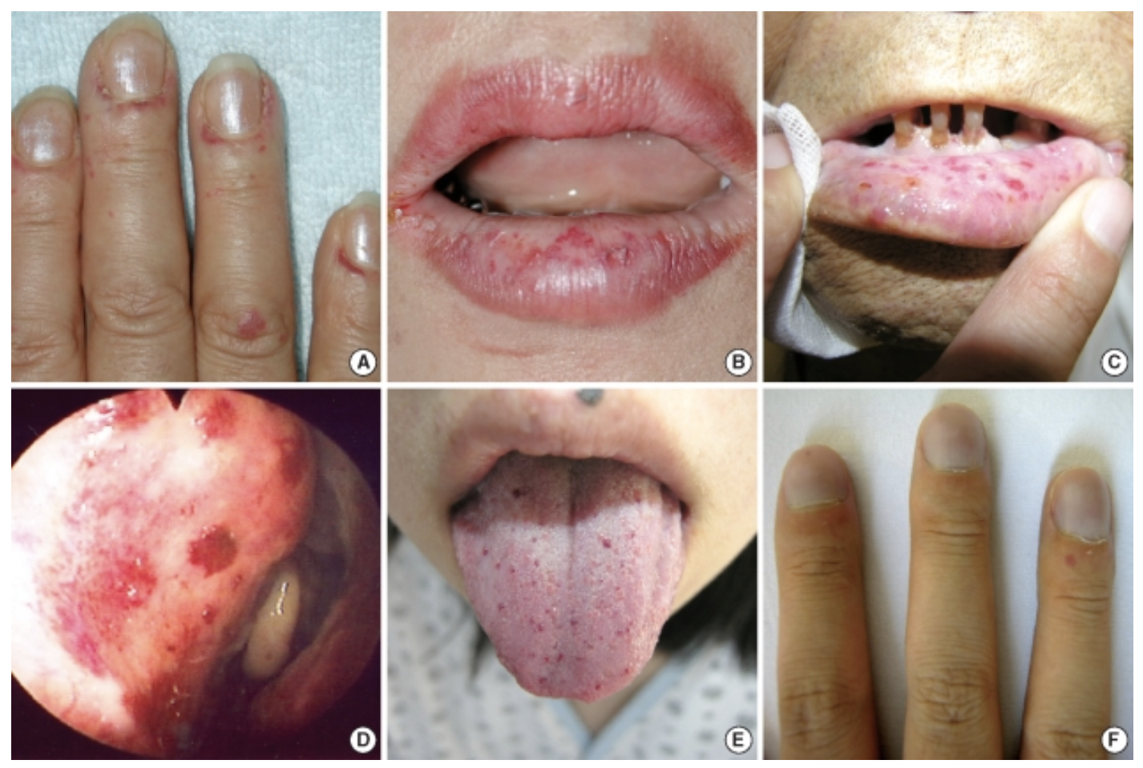
https://www.researchgate.net/figure/Clinical-features-of-the-HHT-patients-A-telangiectasia-on-the-periungal-regions-of-the_fig1_24186207

Slide 5
Retinitis Pigmentosa
Inheritance: AD most common. But patterns variable
Clinical Features:
Peripheral vision and night vision first affected, family history
Associated features: Hearing, unsteadiness (cerebellar)
Fundoscopy Findings: 1) Bone spicules 2) Arteriolar attenuation 3) Optic disc pallor
Associated Syndromes
Kearns-Sayre (mitochondrial): CPEO, deafness, heart block
Usher (AR): Deafness
Refsum (AR): Deafness, cerebellum, peripheral neuropathy, cardiomyopathy
Lawrence-moon-bardet-biedl (AR): Deafness, learning disability, short stature, hypogonadism, renal disease, DM, polydactyly
Treatment: Supportive, genetic counseling

Slide 6
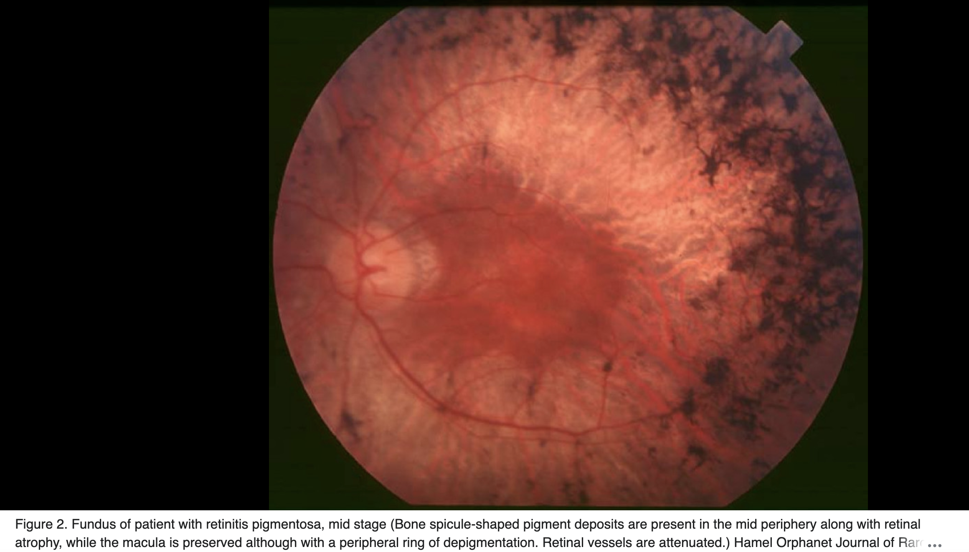
https://en.wikipedia.org/wiki/Retinitis_pigmentosa#/media/File:Fundus_of_patient_with_retinitis_pigmentosa,_mid_stage.jpg

Slide 7
Hereditary Angioedema
Due to deficiency or dysfunction of C1 inhibitor, AD inheritance – swelling is bradykinin mediated
Clinical Features: Recurrent episodes of angioedema (skin, bowel, upper airway) w/o hives or pruritus, no response to antihistamine therapy
Triggers: Trauma, dental work, ace-I, stress, menstruation
Invx: C4 (low), C1NH protein level and function, genetic testing
Management
Acute: C1INH concentrate or bradykin B2 receptor antagonist (Icatibant)
Long term: Can give C1INH injectables

Slide 8
Acute Intermittent Porphyria
Genetics: AD, low penetrance
Triggers: Medications, smoking, sex hormones, reduced caloric intake, stress
Clinical Features
Dark urine
Neurology: Extremity weakness and pain
Gastro: Abdominal pain, vomiting, constipation
Investigations
Main test: Urinary porphobilinogen
Second line: Urinary ALA, PBG, porphyrins, plasma, stool porphyrins
Confirmatory: Decrease erythrocyte PBG deaminase, genetic testing
Management: IV hemin, analgesia, avoid triggers

Slide 9
Osteogenesis Imperfecta
Genetics: Most commonly autosomal dominant
Clinical features
Multiple, minimally or atraumatic fractures
Others: Short stature, scoliosis, blue sclerae, hearing loss, opalescent teeth, skin and ligamentous laxity, easy bruisability
Ddx: Rickets/Osteomalacia
Investigations: Skin biopsy (analysis of type I collagen genes), genetic testing

Slide 10
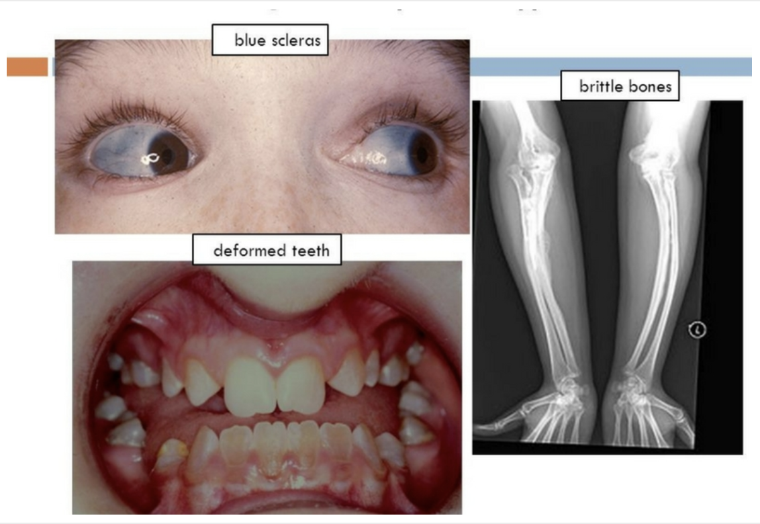
https://www.orthobridgeorthopedics.com/portfolio/osteogenesis-imperfecta/

