Slide 1
PACES Approaches Ep6: Gastro (II) Approaches

Slide 2
Approaches
Vomiting
Jaundice
BGIT

Slide 3
Vomiting
Important associated symptoms: Abdominal pain, giddiness/headache, other GI symptoms (diarrhea, constipation)
Approach
Gastrointestinal: Infective (GE, acute appendicitis), Inflammatory (IBS, systemic sclerosis – but more dysphagia, DM/PM, SLE), Neoplastic (Gastric/esophageal malignancy), Intestinal Obstruction
Hepatobiliary: Cholecystitis, pancreatitis, cholangitis, hepatitis
Genitourinary: Pyelonephritis, ureteric colic, testicular torsion, PID, pregnancy!
CNS:
Central: Bleed, Tumour, Meningitis/Abscess
Vertigo: BPPV, Vestibular neuronitis
Systemic: DKA, Addisonian Crisis (postural giddiness, TCM use), Drugs (chemotherapeutic agents, digoxin toxicity – recent klacid use), Pain
Complications
Electrolyte disturbances
Hypotension/postural hypotension

Slide 4
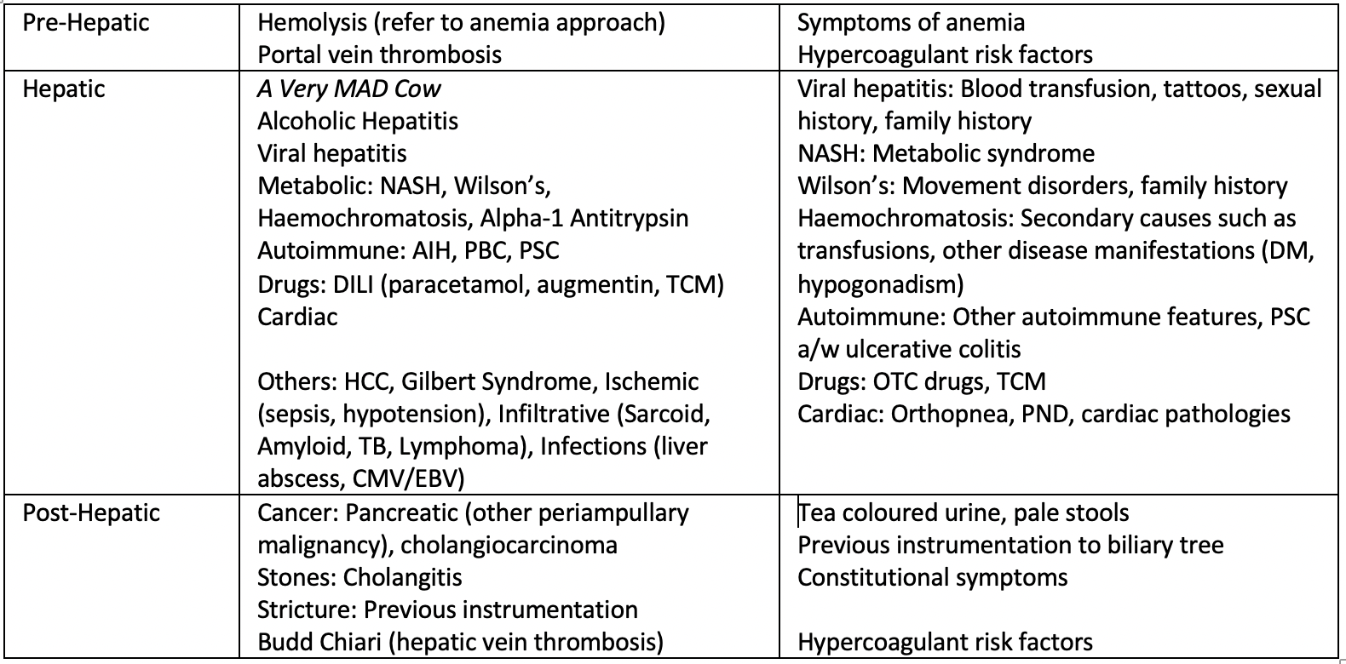
Jaundice

Slide 5
BGIT
Upper BGIT:
Variceal – CLD history
Common: Gastric ca, PUD (think MEN1 with Zollinger Ellison, NSAID use), mallory weiss tear (alcoholc hx), dieulafoy lesions
Syndromes: HHT, Peutz Jegher
Lower BGIT
Massive upper BGIT
Anorectal: Piles
Colon
Non inflammatory: CRC, diverticular bleed, angiodysplasia
Inflammatory: IBD, ischemic colitis (a/w gut claudication, check for AF), infective colitis (think HIV with OIs)
Associations with CRC: Acromegaly, FAP/HNPCC
Coagulopathy: Refer to coagulopathy approach

