Slide 1
PACES Approaches Ep8: Endocrine Approaches

Slide 2
Approaches
Weight Gain/Obesity
Weight Loss
Excessive Sweating
Pituitary Axis
Gynaecomastia
Facial Flushing

Slide 3
Weight Gain and Obesity
Fluid: Cardiac/Hepatic/Renal/Gastro causes of fluid overload
Physiological: -Excessive intake -Reduced physical activity -Genetics
Systemic: -Endocrine: Cushing’s, Hypothyroidism, PCOS, Insulinoma, Acromegaly -Neuro: CNS lesions with hypothalamus involvement -Drugs: Antidepressants/antipsychotic, sulphonylurea, OCP, valproate -Genetics: Prader Willi, Leptin Deficiency

Slide 4
Weight Loss
Establish intentionality of weight loss, appetite (appetite ok in malabsorption/thyroid disorders)
Malignancy: Solid organ, haematological
Endocrine: Hyperthyroidism, DM, Addison’s, Pheochromocytoma
Chronic infections: TB, HIV
Malabsorption: GI pathology (chronic pancreatitis, SIBO – carbohydrate breath test, celiac – IgA anti tissue transglutaminase ab/SI biopsy, lactose intol)
Chronic Disease: CKD, CLD, Heart Failure, COPD
Psychogenic: Depression, anorexia, dementia

Slide 5
Excessive Sweating
Infection: TB, sub-acute/chronic infections (IE, abscess, HIV)
Neoplasm: Haematological malignancies – B symptoms
Endocrine: Pheochromocytoma, hyperthyroidism, acromegaly, carcinoid, hypoglycemia
Others: Autonomic neuropathy

Slide 6
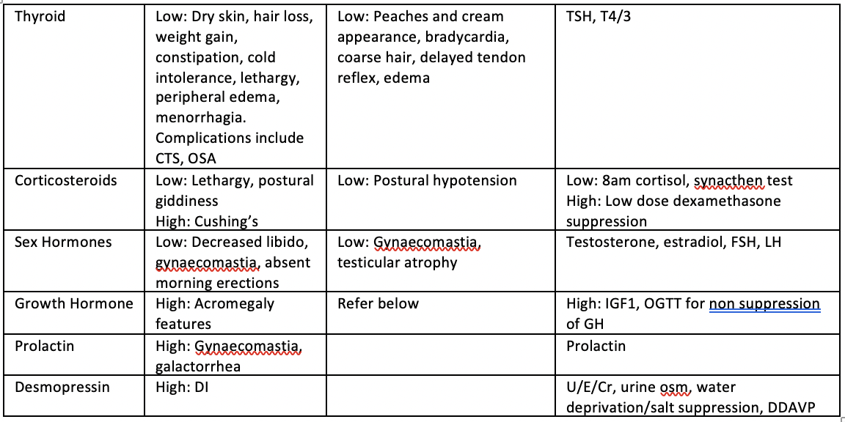
Pituitary Axis
When to Screen: Headache, visual field defect, when one of the axis affected (especially when suspecting central cause)

Slide 7
Panhypopituitarism
Tumour: Primary pituitary, metastatic
Vascular: Hemorrhage (pituitary apoplexy), ischemic (Sheehan syndrome)
Infiltrative: Sarcoidosis, haemochromatosis/iron overload

Slide 8
Gynaecomastia
Hypogonadism: Pituitary tumour, testicular tumour
Hyperthyroidism
CLD, CKD
Drugs: Spironolactone, anti-androgens (dutasteride)
Breast cancer: BRCA
Congenital: Klinefelter syndrome

Slide 9
Facial Flushing
Physiological: Menopause, emotional flushing
Neurological: Autonomic dysfunction
Polycythemia: RCC, PRV
Rash: SLE, Rosacea
Endocrine: Carcinoid, pheochromocytoma, VIPoma, hyperthyroidism, mastocytosis
Drugs: Alcohol, serotonin syndrome, food ingestion (spicy foods)
Others: Mitral stenosis, anaphylaxis, SVCO

